Slide 1

Navigational Robotics Series Robot Car-3 (Encoders & IMU)
Training Slides

Slide 2
Navigational Robot Car-3 (Encoders & IMU)
Review the Contents in the Box
Review & Discuss the Motor Controller Board, Assembly, Power Supply etc.
Discuss the Health & Safety Precautions
Practice the Following Lab
Initial Setup - Car Basic Movements
Test Encoder Motors
A Simple PID Controller for Straight Line Drive
Test Digital Compass (Bearing Angle)

Slide 3
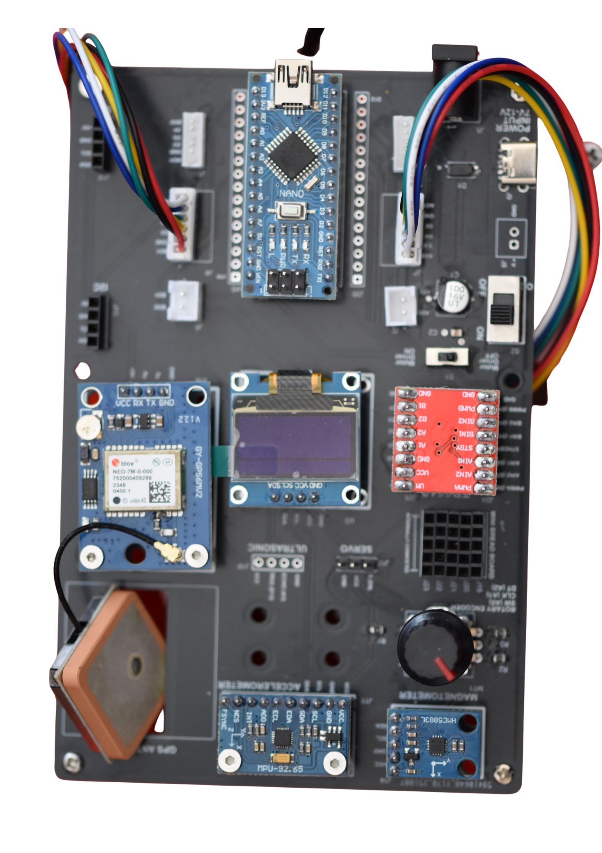
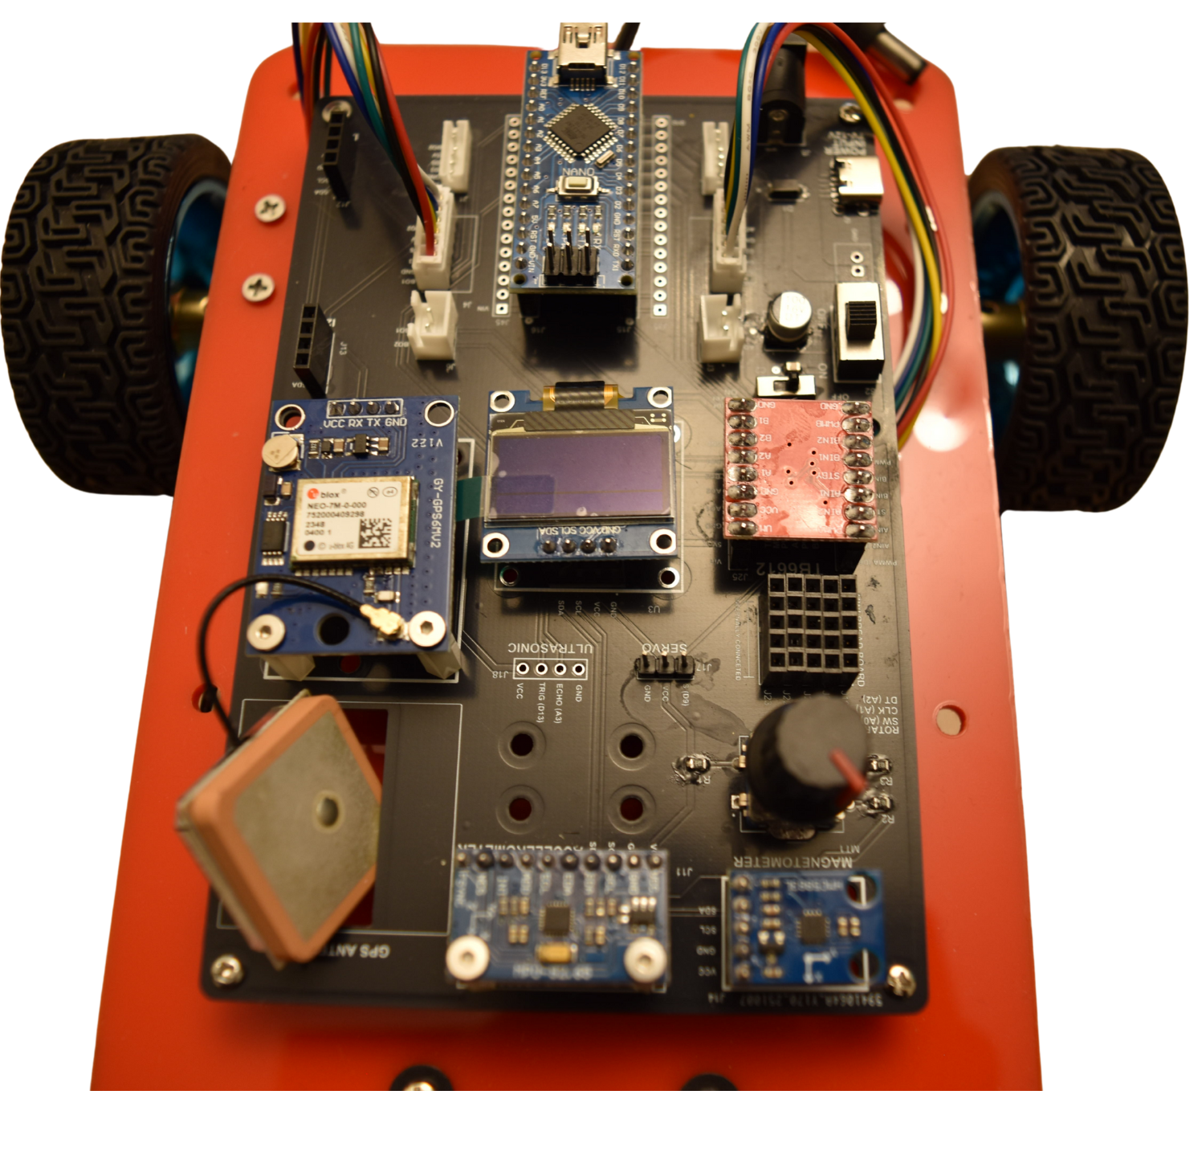
Navigational Robot Car-3 (Encoders & IMU)
4
2
1
3
Parts & Components
Arduino Nao
JGA25-370 6V 130 RPM Encoder Motors
TB6612 Motor Driver
OLED
NEO-6M GPS Module
MPU6050 – Accelerometer
QMC5883 – Digital Compass
Rotary Encoder
Battery Case
Batteries
Battery Charger
5
6
7
9,10,11
8

Slide 4
Navigational Robot Car-3
Learning Outcomes
Encoder Motors Familiarity
Close Loop Control Systems (PID)
IMU Calibration (Accelerometer & Digital Compass)
Sensor Fusion (Filters: Complementary/Kalman/EKF etc.)
Robot Motion Model
Odometry Calculations
Path Planning Algorithms

Slide 5
Health & Safety

Slide 6
Health & Safety
Double-check all power connections. Ensure correct GND and VCC wiring for the power supply, OLED, motor drivers, GPS, sensors, and other modules.
Use the correct input voltage Battery input should be between 5V and 12V only.
Work on a safe surface Use the kit on an insulated table (e.g., wood) and ensure the surface is dry and clean.
Avoid leaving the kit unattended Do not keep the system powered on without supervision.
Build and Test Incrementally Turn on the microcontroller first, then build and test the circuit step-by-step. Avoid wiring the entire system at once and powering it without intermediate testing.
Don’t leave Batteries charging unattended
Robotic car is for in-door use only
Always follow 4-eyes principle when it comes to checking VCC & GND

Slide 7
Motor Driver

Slide 8
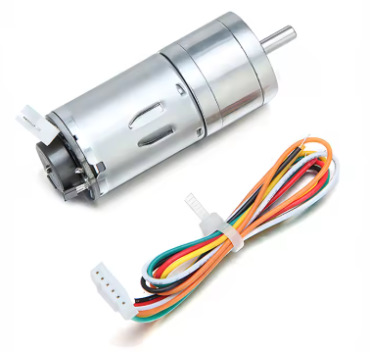
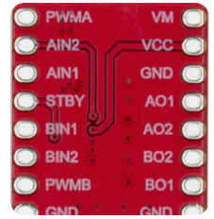
Navigational Robot Car-3
Encoder Motor Specifications
TB 6612 Motor Driver
Series: JGA25-370 6V
Speed: 130 RPM
Voltage: 6V

Slide 9
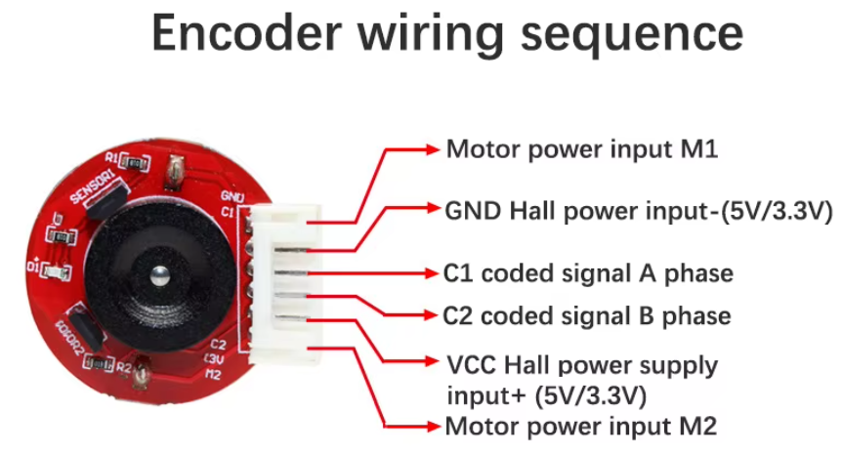
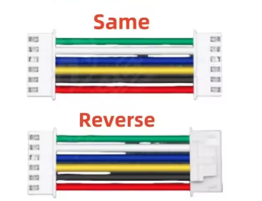
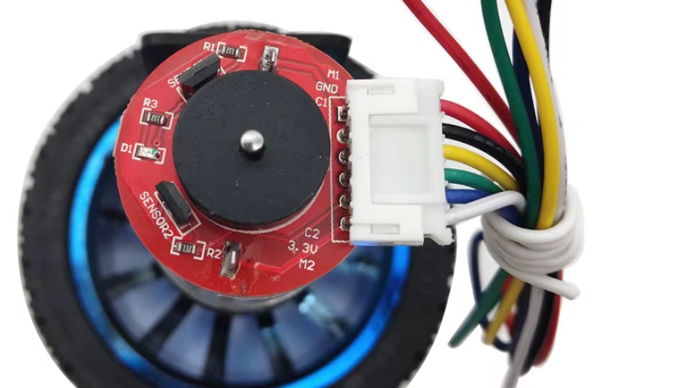
Navigational Robot Car-3
Encoder Motors PINS and Cable
Cable Type – JST PH 2.0 – 6 PIN (Same Side)
When Powered the LEDs on Encoder must light up

Slide 10
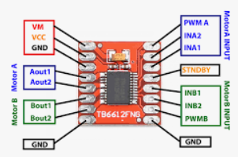
Navigational Robot Car-3
PIN Details - TB6612 Motor Driver and DC370 Motor
Left Motor
A-IN1 – Arduino Nano D8
A-IN2 – Arduino Nano D7
PWMA – Arduino Nano D6
L-Encoder-A - Arduino Nano D2
L-Encoder-B - Arduino Nano D4
Right Motor
B-IN1 – Arduino Nano D12
B-IN2 – Arduino Nano D10
PWMB – Arduino Nano D11
R-Encoder-A - Arduino Nano D3
R-Encoder-B - Arduino Nano D5

Slide 11
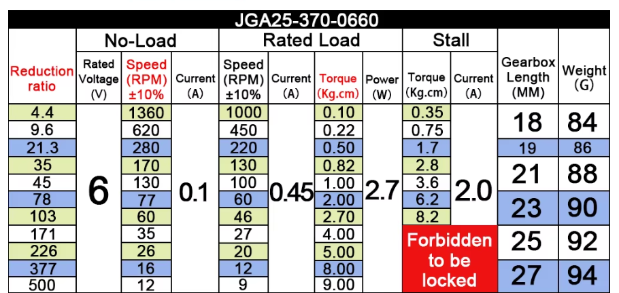
Navigational Robot Car-3
Gear Ratios Table
Disconnect GPS module while uploading the sketch/program to Arduino
If the encoder motors behaviour is random, please check your battery status and may need charging
Beware of encoder motors 6 pin cable as there are 2 version: Same Side & Opposite Side
If you have connected 6 pin cable, and the LED indicators are not ON, then you are likely using an incorrect 6-pin cable
Precautions

Slide 12
Test Basic Movement

Slide 13
Initial Setup - Test Basic Movements
The purpose of this exercise is to test basic movements of the robot car
Also to ensure, your program is using the correct allocated PINs for Motor Inputs (IN1/IN2)
The Program has the following 3 major functional blocks
Pins declaration
Ensure correct pins are defined (see sample program)
B. Setup:
input/outputs
C. Loop:
In the loop the car drives forward/left/right

Slide 14
Initial Setup - Test Basic Movements
// ============== Pin Definitions ==========
// Left Motor
#define IN2_L 8
#define IN1_L 7
// Right Motor
#define IN2_R 10
#define IN1_R 12
Please test each direction in isolation
Forward
Left
Right
If incorrect direction, then swap IN1/IN2 pins of the corresponding motor
Expected Output: The car moves in the desired direction
GitHub Link: https://github.com/info-zas/Training/tree/main/GPREC/06_Navigational_Robot_Car-3-Encoders/01_Code/00_Car3_Basic_Movements

Slide 15
Basic Encoder Motors Functionality

Slide 16
Basic Encoder Motors Functionality
The purpose of this exercise is to test basic encoder motor functionality
Also to ensure, your program is using the correct allocated PWM and Encoder PINs
The Program has the following 3 major functional blocks
Pins declaration
Ensure correct pins are defined (see sample program)
OLED Initialisation for the feedback
B. Setup:
definition of interrupt routines to capture the encoder ticks
C. Loop:
In the loop, as you rotate the left/right motor, you will see the encoder tick counts going up/down depending on the direction of rotation
// === Right Motor Pins ===
#define IN1_R 12
#define IN2_R 10
#define PWM_R 11
#define ENCA_R 3
#define ENCB_R 5
// === Left Motor Pins ===
#define IN1_L 7
#define IN2_L 8
#define PWM_L 6
#define ENCA_L 2
#define ENCB_L 4

Slide 17
Basic Encoder Motors Functionality
The purpose of this exercise is to test basic encoder motor functionality
Also to ensure, your program is using the correct allocated PWM and Encoder PINs
Expected Output
Rotate left/right wheel by hand gradually, you should see the encoder ticks count on OLED screen going up/down depending on the direction.
Accurately measuring the encoder ticks count is the heart of high precision robotics (Odometry Calculations).
Ensure Motor Driver Enable/Disable Switch is in OFF position
GitHub Link:
https://github.com/info-zas/Training/tree/main/GPREC/06_Navigational_Robot_Car-3-Encoders/01_Code/01_Car3_Encoder_Motors_Ticks

Slide 18
Simple PID Controller for Straight Line Drive

Slide 19
Simple PID Controller for Straight Line Drive
The purpose of this program is to demonstrate closed loop control system (PID Controller) for straight line drive
Opportunity fine tune and play Around with Kp/Ki/Kd Parameters
The Program has the following 3 major functional blocks
Pins declaration
Define necessary variables for PID control algorithm and the parameters
B. Setup:
definition of interrupt routines to capture the encoder ticks
C. Loop:
In the loop, calculate the error (difference in ticks between left/right motor), and take corrective action (i.e. change the PWM signal to vary the speed.
GitHub Link:
https://github.com/info-zas/Training/tree/main/GPREC/06_Navigational_Robot_Car-3-Encoders/01_Code/02_Car3_Basic_Straight_Line_PID

Slide 20
Simple PID Controller for Straight Line Drive
The purpose of this program is to demonstrate closed loop control system (PID Controller) for straight line drive
Opportunity fine tune and play Around with Kp/Ki/Kd Parameters
PID Parameters
// PID variables
float error = 0;
float prevError = 0;
float integral = 0;
float derivative = 0;
float Kp = 0.9;
float Ki = -0.01;
float Kd = 0.1;
// Calculate PID
error = ticksLeft - ticksRight;
integral += error;
derivative = error - prevError;
float correction = Kp * error + Ki * integral + Kd * derivative;
Expected Output
Depending on how good the PID parameters, are the car should go in straight line and error should approach zero.

Slide 21
Digital Compass

Slide 22
Digital Compass
The purpose of this exercise is to measure the pose of the robot with some reference point (i.e. Bearing), a first step towards the SLAM
The Program has the following 3 major functional blocks
Pins declaration
Define compass variable
B. Setup:
Initialise compass variable and OLED
C. Loop:
Get raw values and calculate the Bearing.

Slide 23
Digital Compass
Expected Output
You should see the bearing angle (direction X w.r.t to North)
You will realise the need for compass calibration (into the world of high precision robotics)
GitHub Link:
https://github.com/info-zas/Training/tree/main/GPREC/06_Navigational_Robot_Car-3-Encoders/01_Code/03_Car3_DigitalCompass_QMC_Bearing_Scaled_OLED

Slide 24
Q&A

